Slide 1


Intro to
Programming
With python
iteration:
Loops
Friday, February 28 2025 TOH210
Before We Begin (BWB): take out name cards, handing back Quiz1 !
Notes:
Layout objects pulled from: https://slidesgo.com/
All icons are from: https://thenounproject.com/

Slide 2

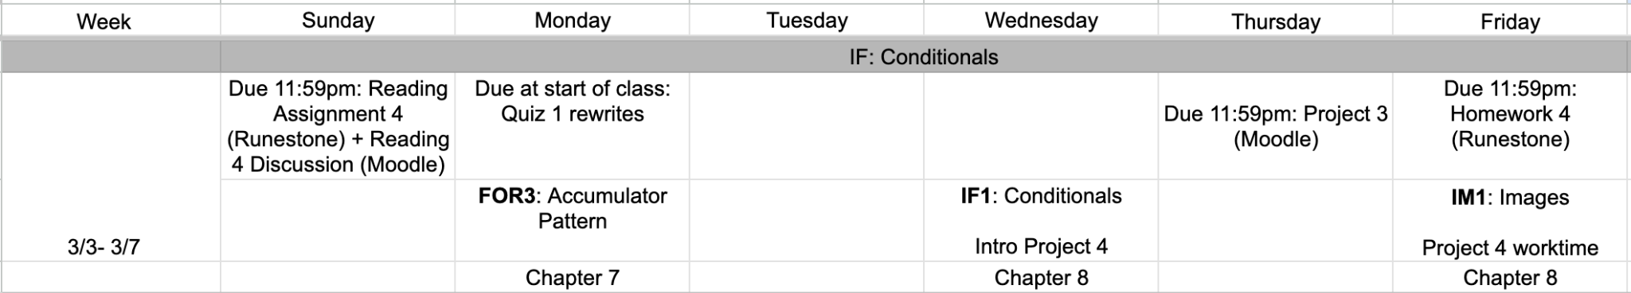
upcoming week
google sheet link

Slide 3
How quizzes are graded
For each of the two standards, you will receive one of three grades:
P - you have full credit for this standard.
R - your solution has a minor error.
If you submit a correct revision to your solution by Monday 3/3 (no extensions possible), this will change to an P
If you submit an incorrect or no revision, this will change to an I
I - you do not yet have credit for this standard. You will be able to reattempt it on Exam I.
Timeline
Quiz 1 will be returned today
Revisions due Monday at the start of class.
Revisions must be written on a separate page*, with the entire question redone (not just the part you missed the first time). This rewrite must be handed in with the original quiz (do not write on the original).
*blank piece of copy paper with your name and standard at the top.

Slide 4
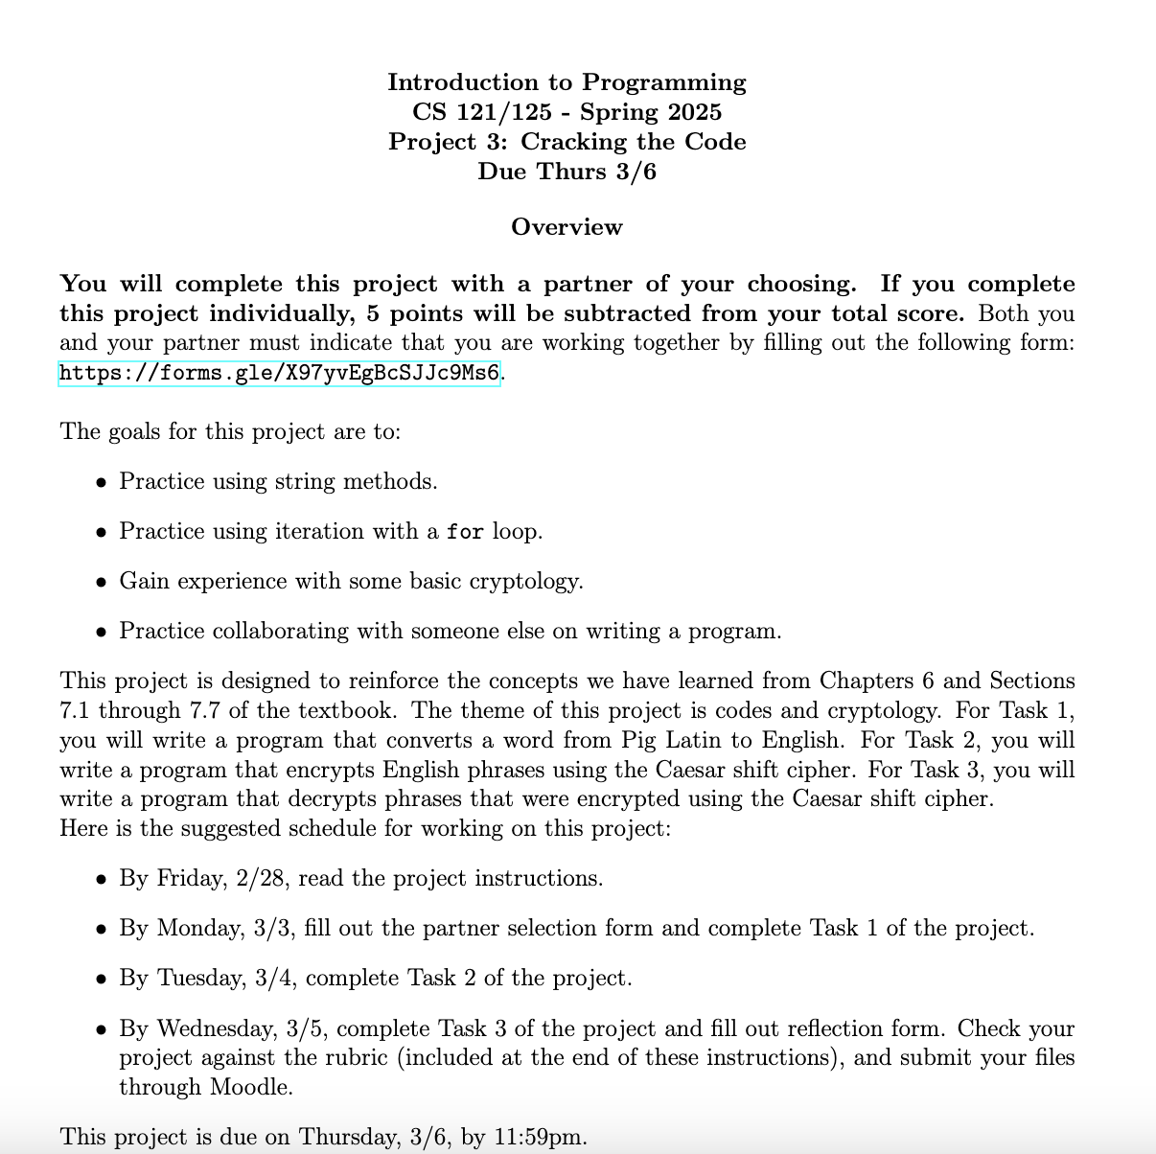
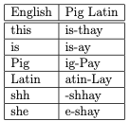

Project 3
group work
task 1
abcdefghijklmnopqrstuvwxyz
0 1 2 3 4 5 6 7 8 9 10 11 12 13 14 15 16 17 18 19 20 21 22 23 24 25
tasks
2 + 3
shift: 2
extra credit
shift: potato
individual work

Slide 5
Loops
colab workbook
click for access
found on Moodle under this week

Slide 6
Takeaways from last time
Things you should know:
lists are sequences and can contain any data types
list indexing, slicing, len(), count(), index()
split() and join()

Slide 7

example
iteration by index
Print out items from a list
color_list = ["pink", "orange", "green", "brown"]
length = len(color_list)
for index in range(length):
print(color_list[index])
0 1 2 3
4
range(4) starts at 0, goes up to (not including) 4 → 0, 1, 2, 3
index first grabs the value 0, and we use list indexing to output the first item in our color_list which is the string “pink”. index keeps grabbing values from the range function up until we get to 4 (end of list)

Slide 8
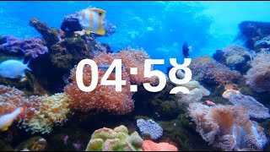
practice
list items and indices
Let’s see if we can fill in the blanks to the following code so that we can get the following output:
0: 6
1: 5
2: 7
3: 8
my_list = [6,5,7,8]
length = ____(____)
for index in ____(____):
print(str(index) +":", ____[index])

Slide 9
follow along in workbook
iteration by index
We can print out items from a list
color_list = ["pink", "orange", "green", "brown"]
length = len(color_list)
for index in range(length):
print(color_list[index])
iteration by item
color_list = ["pink", "orange", "green", "brown"]
for item in color_list:
print(item)

Slide 10
follow along in workbook
iteration by index
Similarly, we can print out characters from a string
color_string = "pink orange green brown"
length = len(color_string)
for index in range(length):
print(index, color_string[index])
iteration by item
color_string = "pink orange green brown"
for char in color_string:
print(char)

Slide 11

practice
workbook
every other character
color_string = "pink orange green brown"
length = len(color_string)
for index in range( , , ):
print(color_string[index])
We can use the range function to go through lists and strings
Try figuring out the arguments to the range function
range(start,stop,step)
0
length
2
Reverse lists
color_list = ["pink", "orange", "green", "brown"]
length = len(color_list)
for index in range( , , ):
print(color_list[index])
length - 1
-1
-1

Slide 12
accumulator Pattern
follow along in workbook
sum numbers
We can use a variable to accumulate something as we iterate through a list or string
numbers_list = [1, 1, 2, 3, 5, 8, 13]
total_sum = 0
for number in numbers_list:
total_sum = total_sum + number
print(total_sum)
total_sum is how we keep track of the running sum of the numbers we have.
it is called our accumulator variable, and the first thing we must do with it is figure out what value to set it to initially
each time our for loop repeats, the number we grab from numbers_list gets added to total_sum and then saved back to total_sum

Slide 13
Exercise
numbers_list = [1, 1, 2, 3, 5, 8, 13]
workbook
Product of numbers
total_product = ____
for number in numbers_list:
total_product = ___________________
print(total_product)
sum of Even indices
total_sum = ____
for index in range(0, len(numbers_list), 2):
total_sum = ___________________
print(total_sum)

Slide 14
Reverse strings
accumulator Pattern
color_string = "pink orange green brown"
length = len(color_string)
reversed_string = “”
for index in range(length-1, -1, -1):
reversed_string = reversed_string + color_string[index]
print(reversed_string)
We can also accumulate to a string, using concatenation

Slide 15

before next time
Submit HW3
Quiz 1 Revision
Reading 4 + Reflection
Look at Project 3, find partner

